Slide 1
Pose Estimation and Shape Matching
Ming-Yu Liu

Slide 2
Outline
Pose estimation
Shape Matching
Fast Directional Chamfer Matching CVPR2010
Pose Estimation for Robotic Assembly ICRA2010
Conclusion

Slide 3
Pose Estimation

Slide 4
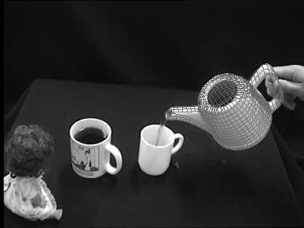
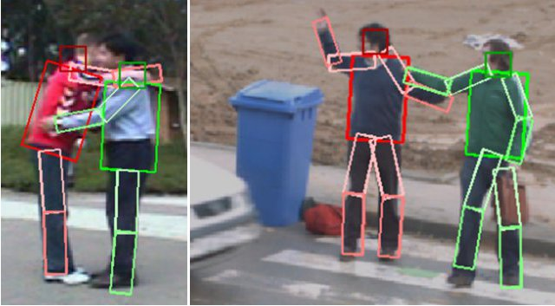
Pose Estimation
Where is the object?
How is it oriented?
By pose we mean the transformation needed to map an object model from its inherent coordinate system into agreement with the sensory data.

Slide 5
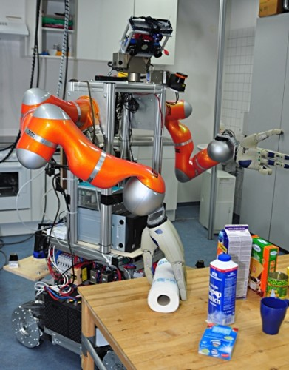
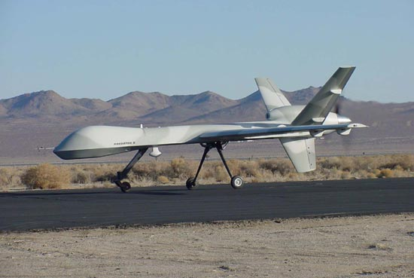
What are the applications?
A UAV needs to know the pose of the ground plane to land safely.
A robot needs to know the pose of the paper tower to grasp it.

Slide 6
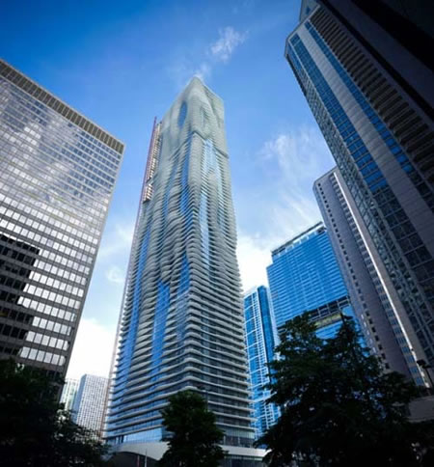
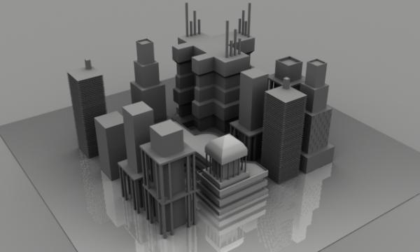
Know where you are by looking at the skyline.
Given a photo of a city view, we can match the skyline to the 3D model of the city. From the matching, we can identify our locations.

Slide 7
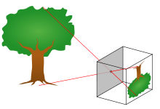
Pinhole Camera Model
The pinhole camera model describes the mathematical relationship between the coordinates of a 3D point and its projection onto the image plane of an ideal pinhole camera, where the camera aperture is described as a point and no lenses are used to focus light.
(X_{i} , Y_{i}, Z_{i})
f
pinhole

Slide 8
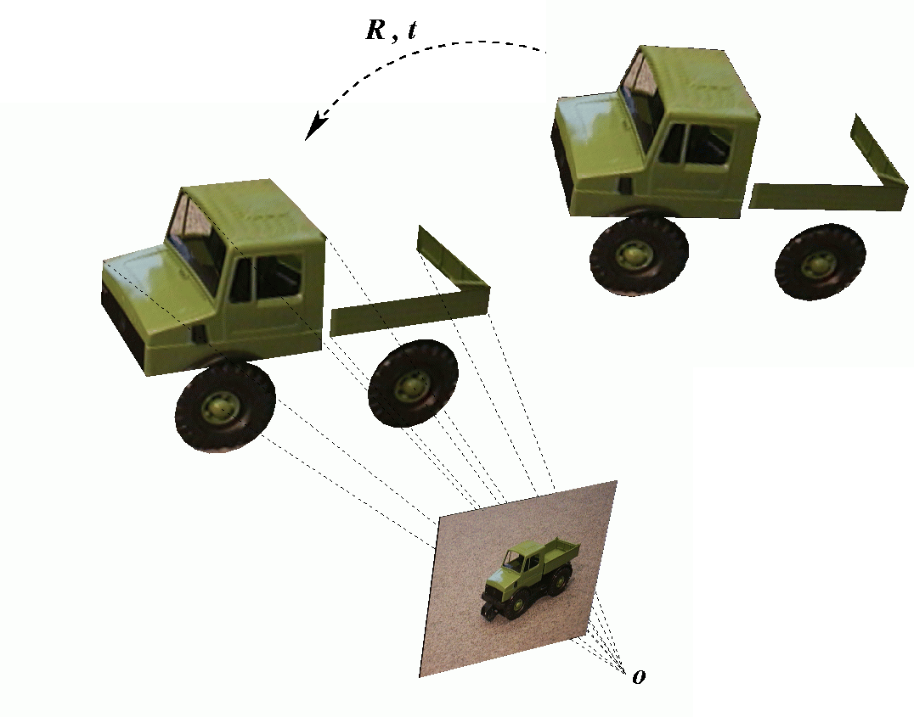
Model-based pose estimation
Given an image and the 3D model of an object, what are the minimum number of correspondences that we need to solve the pose estimation problem?
How many points do we need to compute (R,t)?

Slide 9
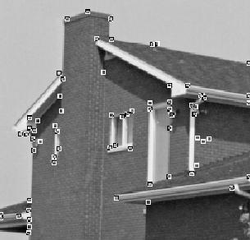
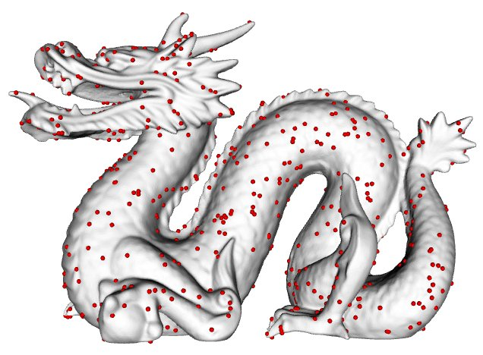
Build the correspondence
Extract feature points from the 2D image.
Match the 2D image points to the 3D model points.
How to extract feature points? SIFT, SURF, Harris corner detector

Slide 10
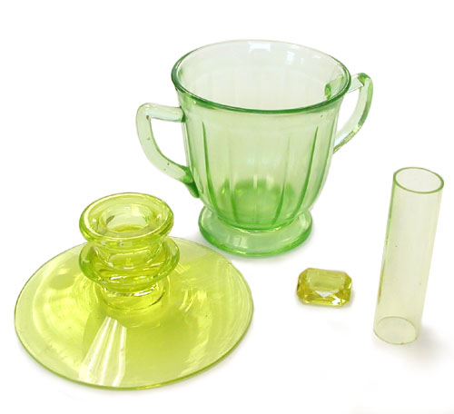
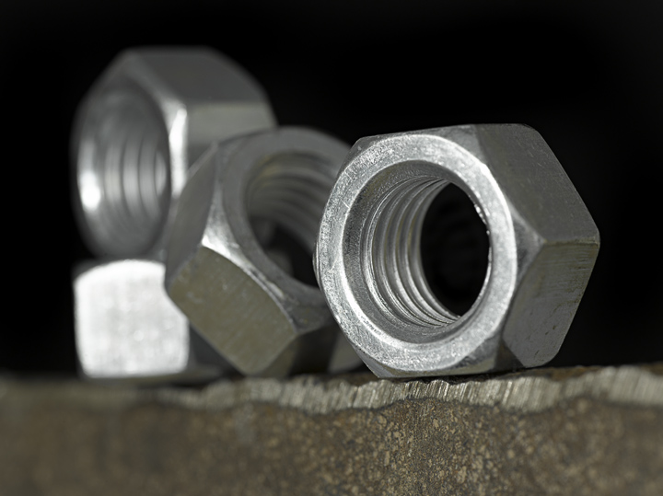
Feature points are not always available.
Specular objects
Transparent objects
We might need to resort to other source of information for determining the object pose.

Slide 11
Shape Matching

Slide 12
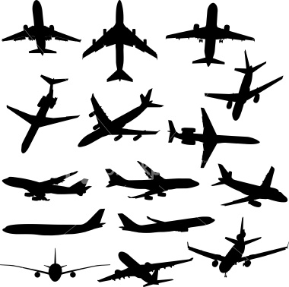

Shapes
The shape of an object located in some space is a geometrical description of the part of that space occupied by the object, as determined by its external boundary.
Shape encodes the pose information.

Slide 13
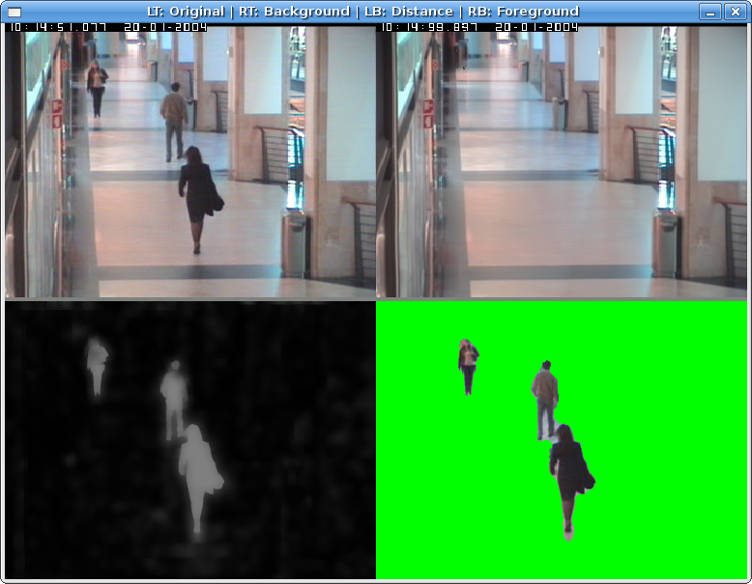
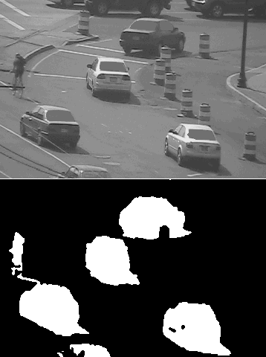
How do we extract shapes?
Background subtraction.

Slide 14
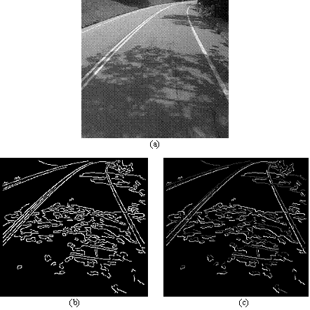
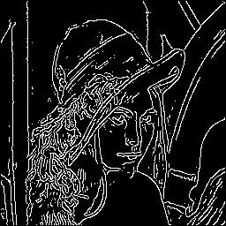
Canny Edge Detection

Slide 15
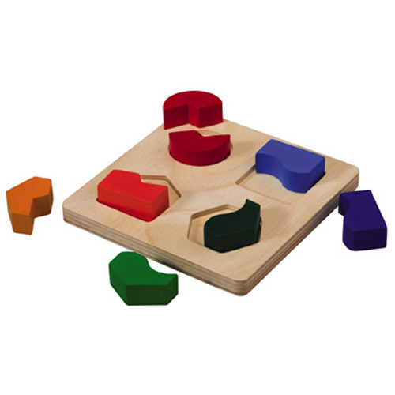
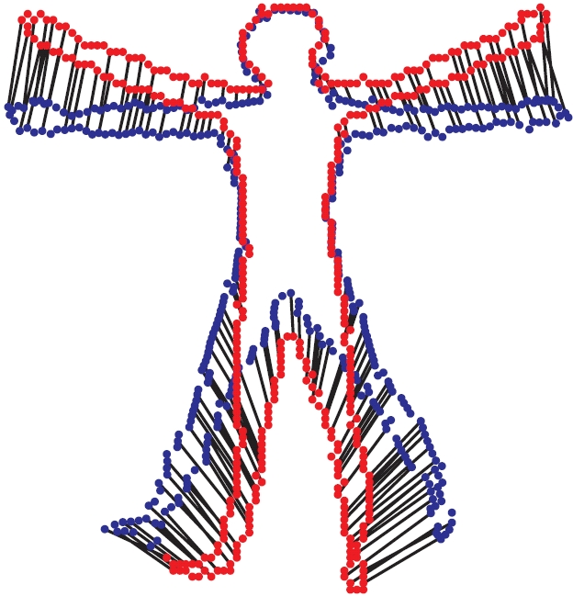
Shape Matching
A process of comparing two shapes.
Match objects to their spot on the board.

Slide 16
Fast Directional
Chamfer Matching

Slide 17
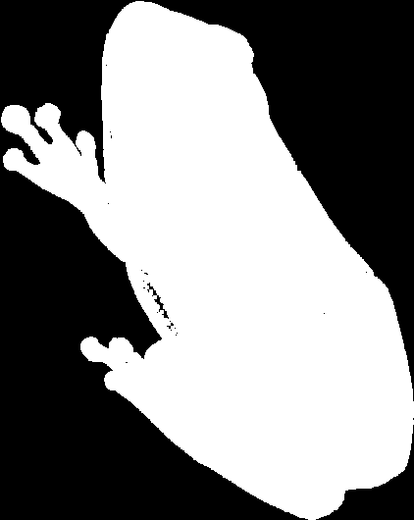
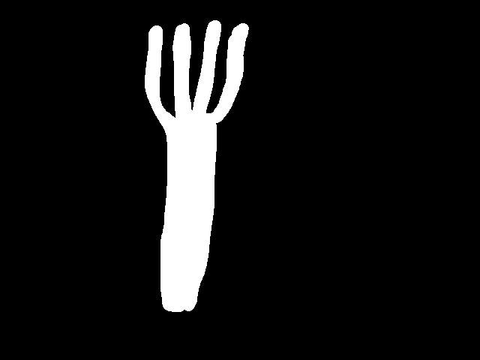



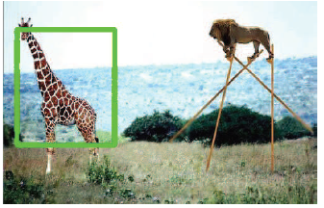
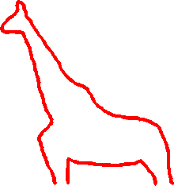
Shape
What is the object?
Shape provides rich information about the object identity and pose
Earlier researches on shape analysis focuses on modeling shape invariance for object recognition.
We focus on localizing an object instance in the image using shape information.
query
Where is the object?

Slide 18
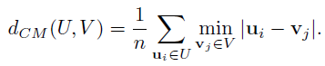
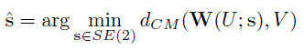
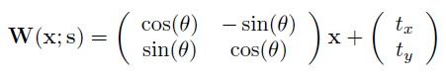
Chamfer Matching
Chamfer Matching defines the distance between two sets of edge maps
as
and solve for the optimal alignment parameters
where

Slide 19
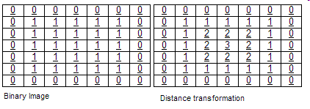
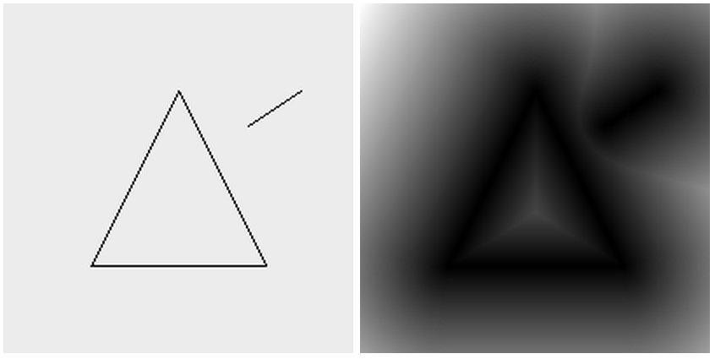
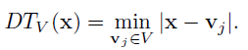
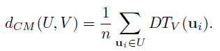
Distance Transform
Distance transform is an intermediate image representation where the map labels each pixel of the image with the distance to the nearest zero pixel.
Chamfer matching costs can be evaluated efficiently
through the distance transform structure

Slide 20
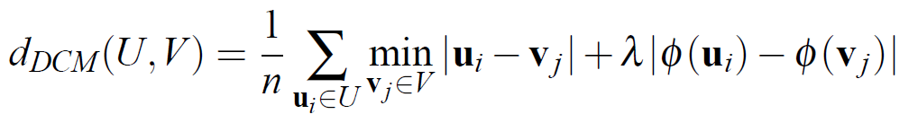
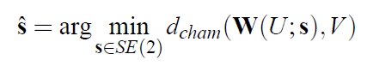
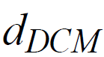
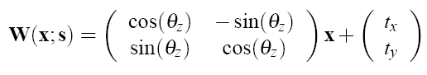
Directional Chamfer Matching
We improve the Chamfer Matching cost by considering edge orientation
We define the distance between two sets of edge maps as
and solve for the optimal alignment parameters
where

Slide 21
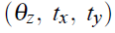
Matching Cost Computation
The search problem requires optimization over three parameters of planer Euclidean transformation, , for each of the k templates stored in the database
Given a 640x480 query image and a database of k = 300 edge templates, the brute-force search requires more than 10¹⁰ evaluations of the cost function
We present several optimization techniques including
Linear representation
3D distance transform
Distance transform integral
Bounding function
to achieve sublinear time computation of the matching cost.

Slide 22
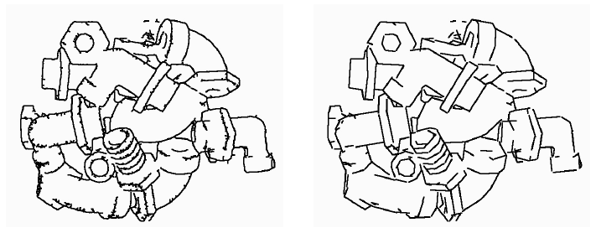
Linear Representation
We fit line segments to edges and each template pose is represented with a collection of m-line segments
Compared with a set of points which has cardinality n, its linear representation
is more concise. It requires only O(m) memory to store an edge map where m << n
Edge image. The image contains
11542 edge points
Line image. The image contains
300 line segments

Slide 23
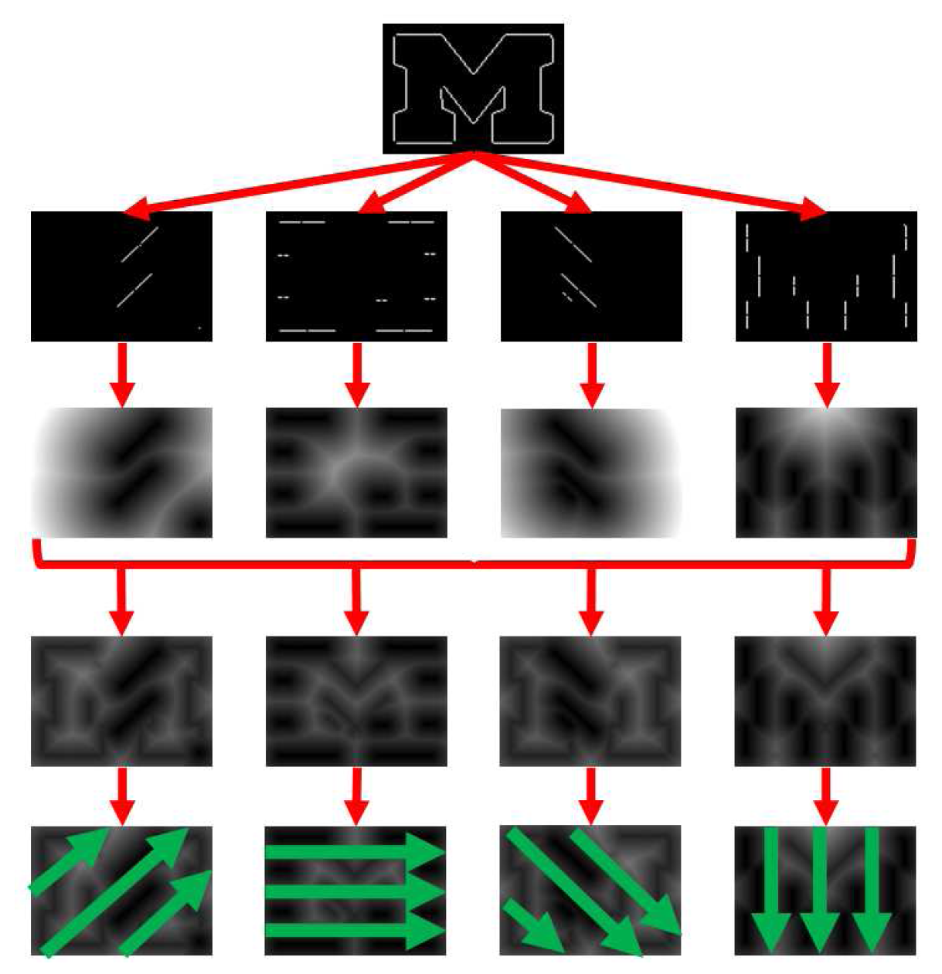
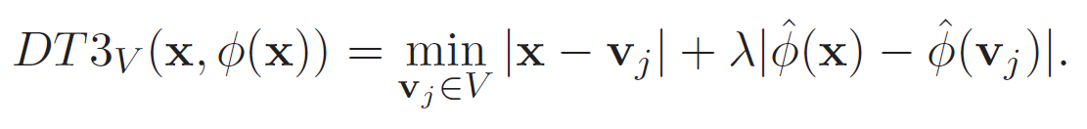
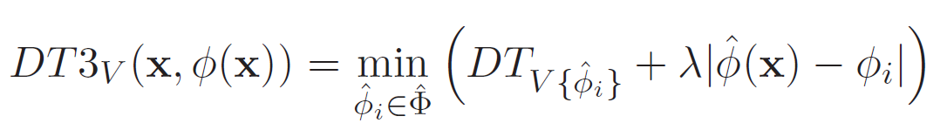
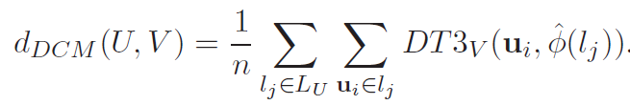
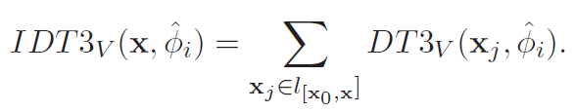
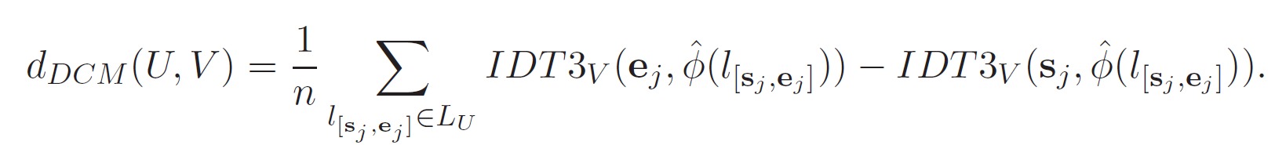
3D Distance Transform Integral
Edges are quantized into discrete orientation channels.
Query edge map
2D distance transform of each orientation channel.
3D distance transform based on the orientation cost
3D distance transform integral
Final cost evaluation
O(n) → O(m)

Slide 24
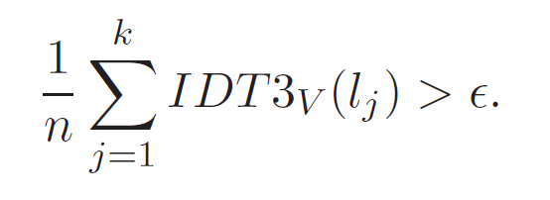
Search Optimization
O(m) complexity is just an upper bound.
We sort the template line segments in the decreasing order of length. In the case of searching for the best matcher, we can keep track of the matching cost.
Let be the current minimum cost. We can skip the cost evaluation
whenever
where
The number of evaluated line segment matching costs is much less than m.

Slide 25
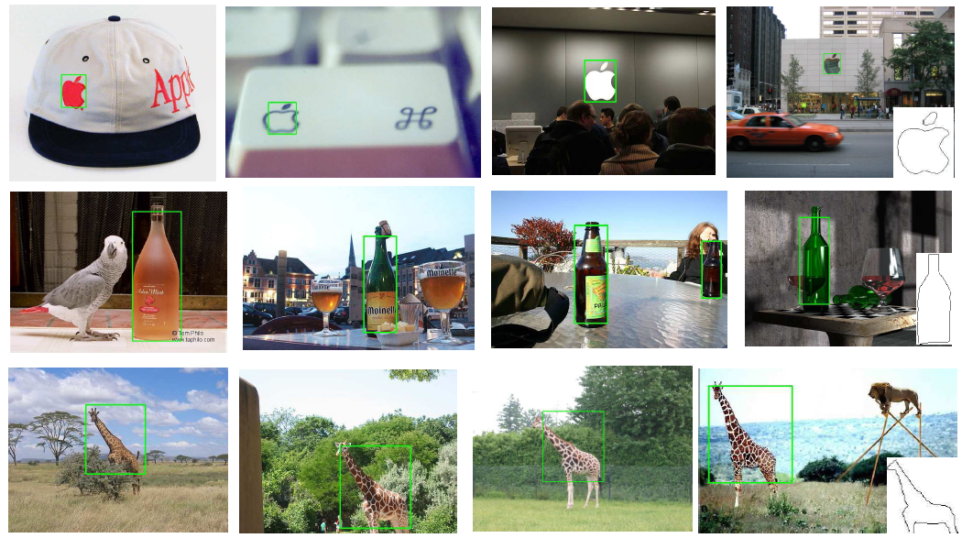
Some matching results

Slide 26
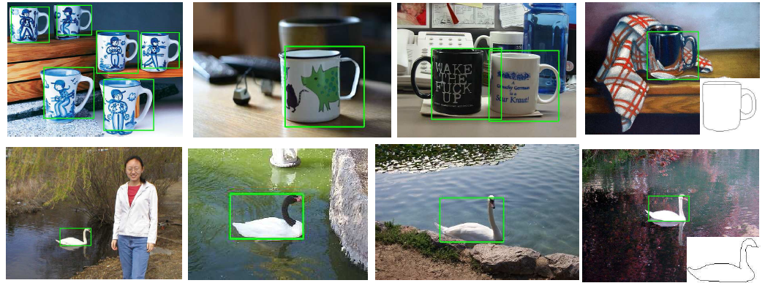

Slide 27
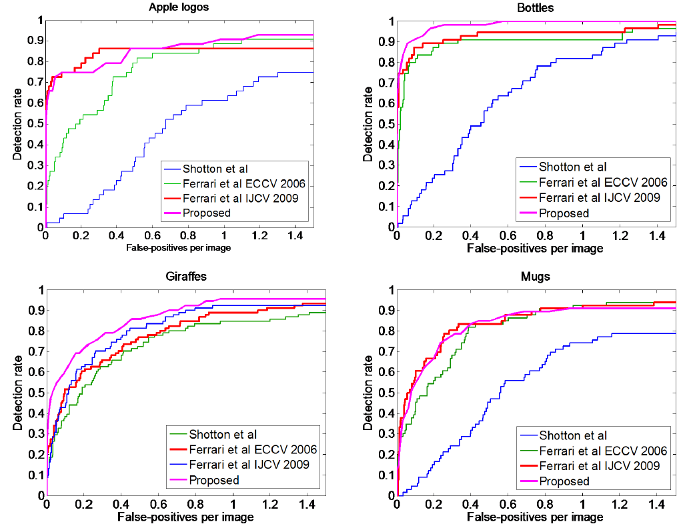
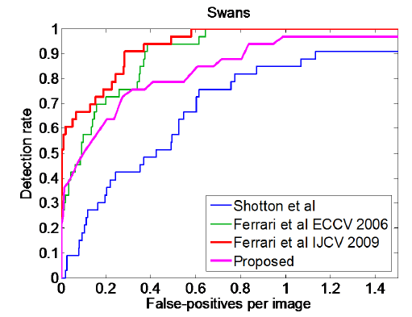
Receiver Operating Curves

Slide 28
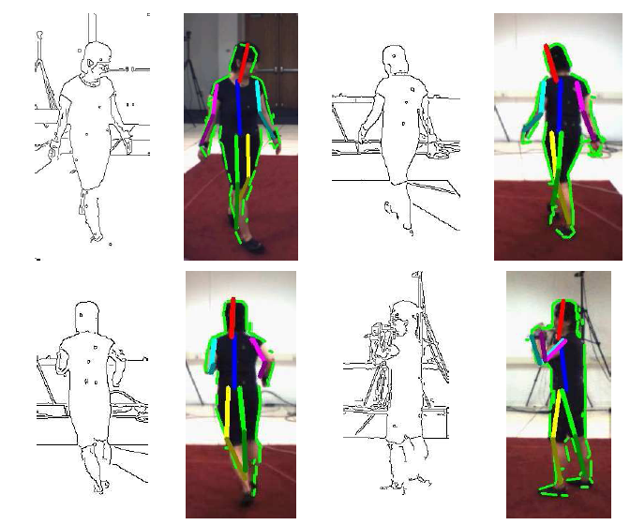
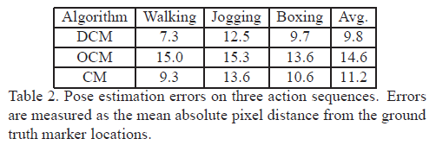
Extension on HumanEva Dataset
We use a set of human silhouettes with known poses as the template and match them in a given image. The pose of best matcher serves as the estimated human pose.
The proposed algorithm can evaluate
1.1 millions hypotheses per second.

Slide 29
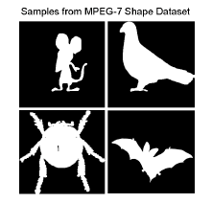

Evidence of Sublinear Complexity
The complexity of Chamfer Matching is O(nK) where n is the number of edge pixels and K is the number of hypothesis.
Line segment representation O(nK) => O(mK) where m is the number of line segments.
We order the line representation according to their supports. Only a small portion of line segments are actually evaluated (20~30%) for object localization.
Actually, O(nK) => O(ηK), where η is a sublinear function of n.
Linear complexity
η/n
Sub-linear complexity
n

Slide 30
Robotic Assembly System

Slide 31



Object Detection and Pose Estimation for Robotic Assembly
Human Labor
to Robot Labor
Objects must be
carefully placed before
robot operates
Invention of interchangeable parts
How about this?
Computer Vision Based Solution
The goal is to detect and localize a target object in a cluttered bin and to accurately estimate its pose using cameras. The robot can then use this estimate to grasp the object and perform subsequent manipulation.

Slide 32

System Overview
Algorithmic Layout

Slide 33

Multi-Flash Camera

Slide 34

LED 1 – I₁

Slide 35

LED 2 – I₂

Slide 36

LED 3 – I₃

Slide 37

LED 4 – I₄

Slide 38

LED 5 – I₅

Slide 39

LED 6 – I₆

Slide 40

LED 7 – I₇

Slide 41

LED 8 – I₈

Slide 42

Depth Edges
Edges detection
using Canny
edge detector
Depth Edges
Using MFC

Slide 43
Database Generation
The database is generated by rendering the CAD model of the object with respect to sampled 3D rotations at the fixed location.
We sample k out-of-plane rotations uniformly on the space and generate the depth edge templates.
We exclude inplane rotations from the database and solve for the optimal
in-plane rotation parameter during matching

Slide 44

1D Line Search
The linear representation provides an efficient method to reduce the size of the search space.
The search time is invariant to the size of the image and is only a function of number of template and query image lines.

Slide 45
Pose Refinement
The scene is imaged with MFC from a second location
We jointly minimize the reprojection error in two views via continuous optimization (ICP and Gauss-Newton) and refine the pose

Slide 46
System Overview
Algorithmic Layout

Slide 47
Experiments

Slide 48

Experiments on Synthetic Data

Slide 49

Experiments on Synthetic Data

Slide 50
Experiments on Synthetic Data
Detection performance comparison
Detection Rate | Circuit Breaker | Mitsubishi Logo | Ellipse Toy | T-Nut | Knob | Wheel | Avg.
Propsed | 0.97 | 0.99 | 0.95 | 0.89 | 0.96 | 0.92 | 0.95
OCM [1] | 0.95 | 0.95 | 0.86 | 0.83 | 0.96 | 0.83 | 0.90
Chamfer Matching [2] | 0.89 | 0.78 | 0.74 | 0.66 | 0.74 | 0.78 | 0.76
[1] J. Shotten, A. Blake, and R. Cipolla. Multiscale categorical object recognition using contour fragment, PAMI 2008
[2] H. G. Barrow, J. M. Tenenbaum, R. C. Bolles, and H. C. Wolf, "Parametric correspondence and chamfer matching: Two new techniques for image matching," in Proc. 5th Int. Joint Conf. Artificial Intelligence 1977

Slide 51








Experiments on Real Data ( Matching )

Slide 52

Experiment On Real Data ( Pose Refinement )

Slide 53
Pose Estimation Performance on Real Data
highly accurate. ( 1mm and 2⁰ )

Slide 54

System Demo

Slide 55
Conclusion

Slide 56
Conclusion
We discussed the problem of pose estimation.
We discussed the problem of shape matching.
We show that Chamfer matching cost function can be improved by integrating edge orientation information.
We show optimization techniques to reduce the complexity of chamfer matching from linear to sublinear.
Multi-Flash Camera provides accurate separation of depth edges and texture edges and can be utilized for object pose estimation even in heavy clutter.
We present a highly accurate and efficient robotic assembly system.

Slide 57








Acknowledgement
Rama Chellappa
Oncel Tuzel
Ashok Veeraraghavan
Yuichi Taguchi
Amit Agrawal
Tim K. Marks
John Barnwell
Srikumar Ramalingam

Slide 58
Thank You

